Slide 1
Midpoint Circle Algorithm
Notes:
Spring 2006
CS5600

Slide 2
More Raster Line Issues
Fat lines with multiple pixel width
Symmetric lines
End point geometry – how should it look?
Generating curves, e.g., circles, etc.
Jaggies, staircase effect, aliasing...
Prepared by Narendra V G CSE MIT
Notes:
Spring 2006
CS5600

Slide 3
Generating Circles
Prepared by Narendra V G CSE MIT
Notes:
Spring 2006
CS5600

Slide 4
Where do we draw a circle???
Properties of a circle:
A circle is defined as a set of points that are all the given distance (x_{c},y_{c}). This distance relationship is expressed by the pythagorean theorem in Cartesian coordinates as
(x – x_{c})² + (y – y_{c}) ² = r²
We could use this equation to calculate the points on the circle circumference by stepping along x-axis in unit steps from x_{c}-r to x_{c}+r and calculate the corresponding y values at each position as
y = y_{c} +(- ) (r² – (xc –x )²)^{1/2}
This is not the best method:
  Considerable amount of computation
  Spacing between plotted pixels is not uniform

Slide 5
Polar co-ordinates for a circle
We could use polar coordinates r and θ,
x = x_{c} + r cosθ y = y_{c} + r sinθ
A fixed angular step size can be used to plot equally spaced points along the circumference
A step size of 1/r can be used to set pixel positions to approximately 1 unit apart for a continuous boundary
But, note that circle sections in adjacent octants within one quadrant are symmetric with respect to the 45 deg line dividing the to octants
Thus we can generate all pixel positions around a circle by calculating just the points within the sector from x=0 to x=y
This method is still computationally expensive

Slide 6
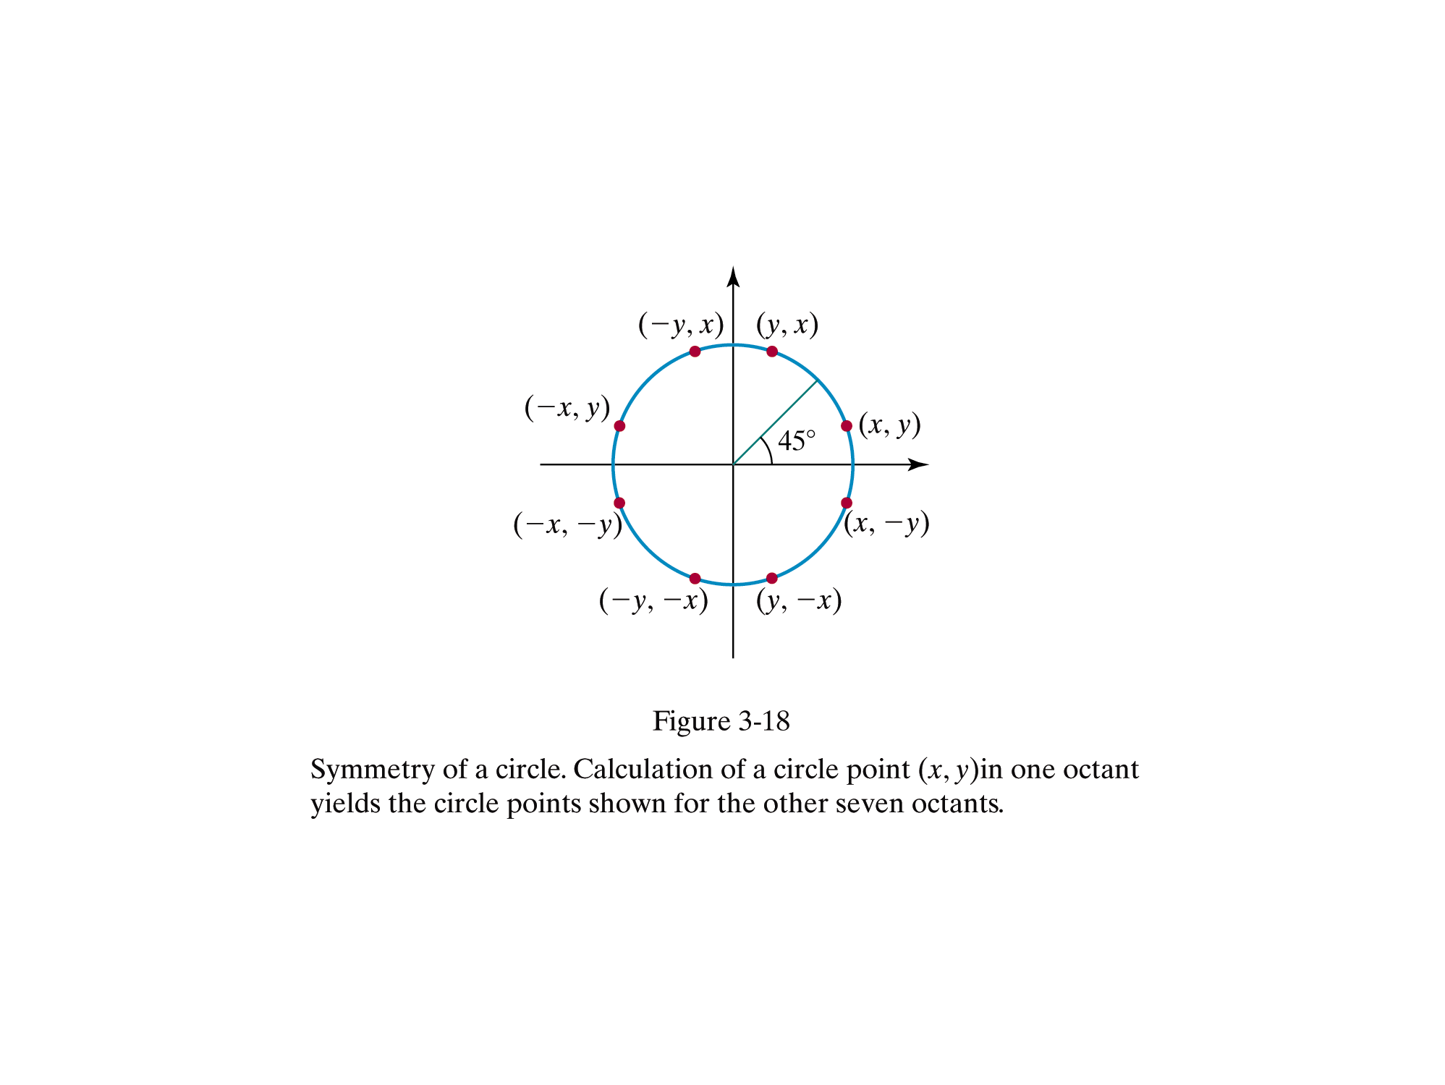

Slide 7
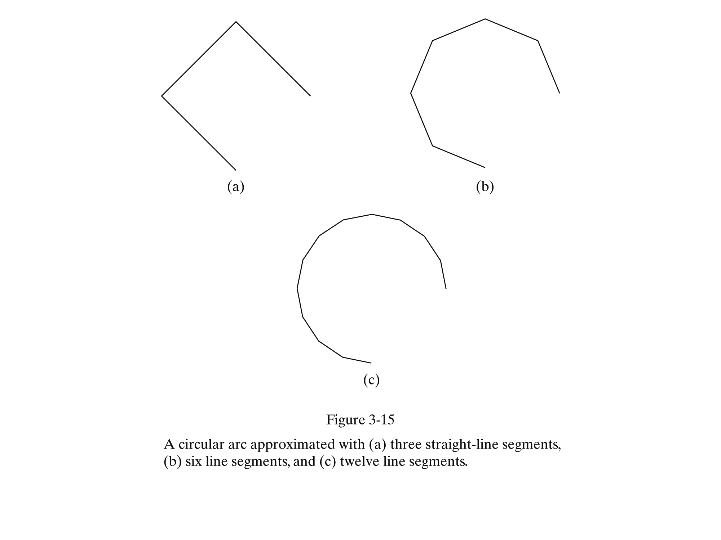

Slide 8
Bresenham to Midpoint
Bresenham requires explicit equation
  Not always convenient (many equations are implicit)
  Based on implicit equations: Midpoint Algorithm (circle, ellipse, etc.)
  Implicit equations have the form F(x,y)=0.

Slide 9
Midpoint Circle Algorithm
We will first calculate pixel positions for a circle centered around the origin (0,0). Then, each calculated position (x,y) is moved to its proper screen position by adding xc to x and yc to y
Note that along the circle section from x=0 to x=y in the first octant, the slope of the curve varies from 0 to -1
Circle function around the origin is given by
fcircle(x,y) = x² + y² – r²
Any point (x,y) on the boundary of the circle satisfies the equation and circle function is zero

Slide 10
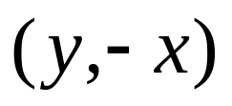
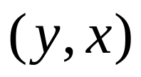
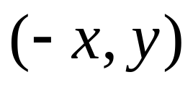
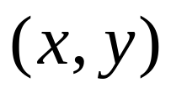
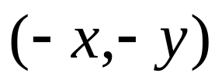
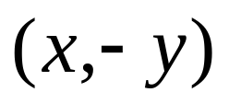
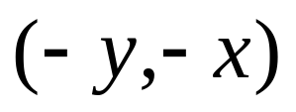
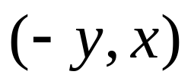
Exploit 8-Point Symmetry
Prepared by Narendra V G CSE MIT
Notes:
Spring 2006
CS5600

Slide 11
Once More: 8-Pt Symmetry
Prepared by Narendra V G CSE MIT
Notes:
Spring 2006
CS5600

Slide 12
Only 1 Octant Needed
We will generate 2nd Octant
Prepared by Narendra V G CSE MIT
Notes:
Spring 2006
CS5600

Slide 13
Generating pt (x,y) gives
the following 8 pts by symmetry:
{(x,y), (-x,y), (-x,-y), (x,-y),
(y,x), (-y,x), (-y,-x), (y,-x)}
Prepared by Narendra V G CSE MIT
Notes:
Spring 2006
CS5600

Slide 14
2nd Octant Is a Good Arc
It is a function in this domain
  single-valued
  no vertical tangents: |slope|  1
Lends itself to Bresenham
  only need consider E or SE
Prepared by Narendra V G CSE MIT
Notes:
Spring 2006
CS5600

Slide 15
Implicit Eq’s for Circle
Let F(x,y) = x ² + y ² – r ²
For (x,y) on the circle, F(x,y) = 0
So, F(x,y) > 0 ⇒ (x,y) Outside
And, F(x,y) < 0 ⇒ (x,y) Inside
Prepared by Narendra V G CSE MIT
Notes:
Spring 2006
CS5600

Slide 16
Choose E or SE
Function is x ² + y ² – r ² = 0
So, F(M)  0 ⇒ SE
And, F(M) < 0 ⇒ E
Prepared by Narendra V G CSE MIT
Notes:
Spring 2006
CS5600

Slide 17
Decision Variable d
Again, we let,
d = F(M )
Prepared by Narendra V G CSE MIT
Notes:
Spring 2006
CS5600

Slide 18
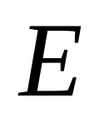


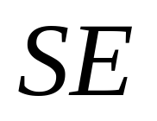
Look at Case 1: E
ideal curve
Prepared by Narendra V G CSE MIT
Notes:
Spring 2006
CS5600

Slide 19
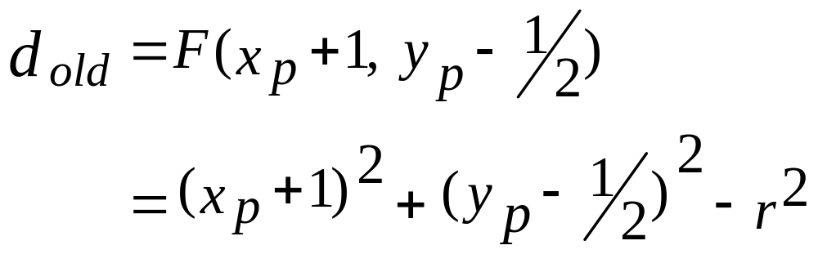
d_{old} < 0 ⇒ E
Prepared by Narendra V G CSE MIT
Notes:
Spring 2006
CS5600

Slide 20
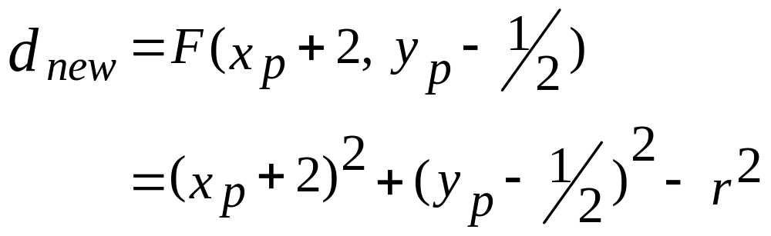
d_{old} < 0 ⇒ E
Prepared by Narendra V G CSE MIT
Notes:
Spring 2006
CS5600

Slide 21
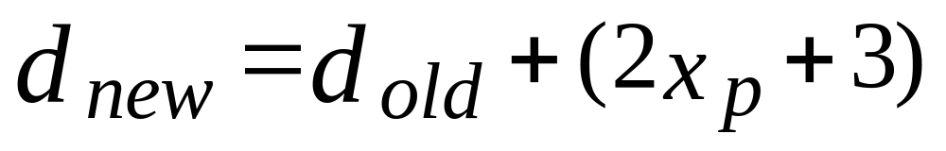
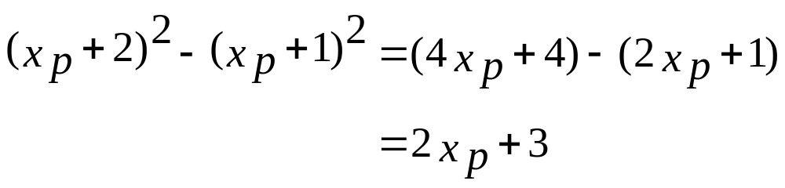
d_{old} < 0 ⇒ E
Since,
Prepared by Narendra V G CSE MIT
Notes:
Spring 2006
CS5600

Slide 22
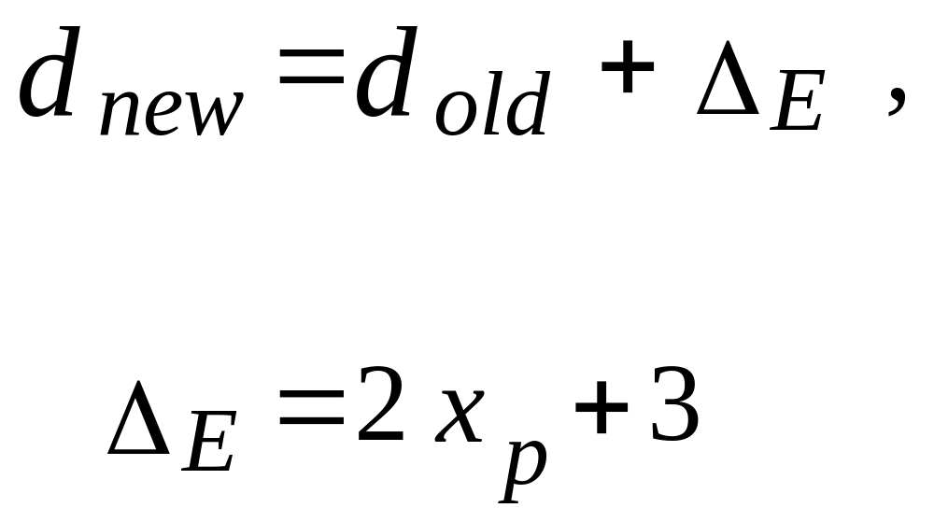
d_{old} < 0 ⇒ E
where,
Prepared by Narendra V G CSE MIT
Notes:
Spring 2006
CS5600

Slide 23
Look at Case 2: SE
ideal curve
Prepared by Narendra V G CSE MIT
Notes:
Spring 2006
CS5600

Slide 24
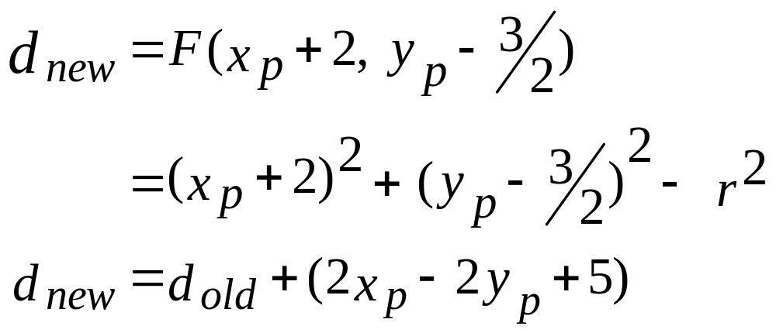
d_{old}  0 ⇒ SE
Because,…, straightforward manipulation
Prepared by Narendra V G CSE MIT
Notes:
Spring 2006
CS5600

Slide 25
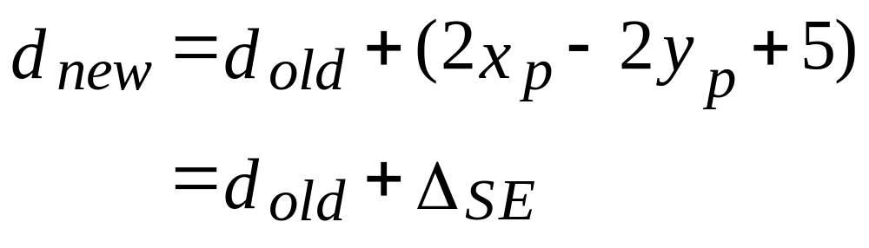
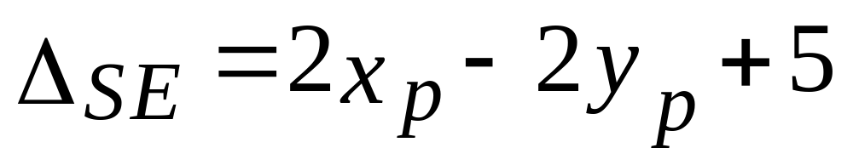
d_{old}  0 ⇒ SE
I.e.,
Prepared by Narendra V G CSE MIT
Notes:
Spring 2006
CS5600

Slide 26
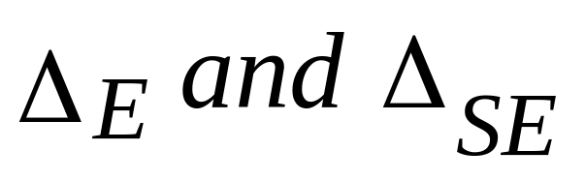
Note: Δ΄s Not Constant
depend on values of x_{p} and y_{p}
Prepared by Narendra V G CSE MIT
Notes:
Spring 2006
CS5600

Slide 27
Summary
Δ΄s are no longer constant over entire line
Algorithm structure is exactly the same
Major difference from the line algorithm
  Δ is re-evaluated at each step
  Requires real arithmetic
Prepared by Narendra V G CSE MIT
Notes:
Spring 2006
CS5600

Slide 28
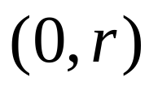
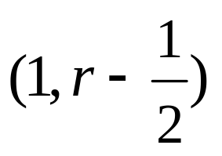
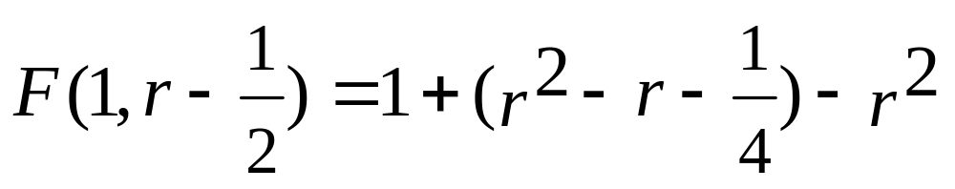
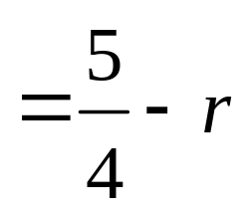
Initial Condition
Let r be an integer. Start at
Next midpoint M lies at
So,
Prepared by Narendra V G CSE MIT
Notes:
Spring 2006
CS5600

Slide 29
Circle Algorithm
void MidPointCircle(int radius )
{
x = 0;
y = radius;
d = (5/4) - radius;
Circle_Points(x,y);
while(y>x)
{
If (d < 0) /*Select E */
d = d + 2*x + 3
else
{ /*Select SE */
d= d + 2*(x-y) + 5
y = y-1;
}
x = x+1;
Circle_Points(x,y);
}
Circle_Points(int x, int y)
{
putpixel(x,y);
putpixel(y,x);
putpixel(x,-y);
putpixel(y,-x);
putpixel(-x,-y);
putpixel(-y,-x);
putpixel(-x,y);
putpixel(-y,x);
}

Slide 30
Getting to Integers
Note the previous algorithm involves real arithmetic
Can we modify the algorithm to use integer arithmetic?
Prepared by Narendra V G CSE MIT
Notes:
Spring 2006
CS5600

Slide 31
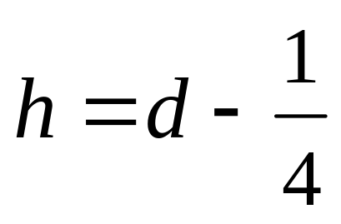
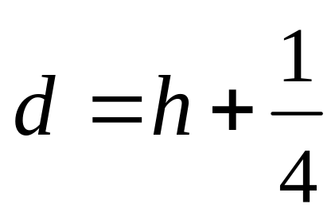
Integer Circle Algorithm
Define a shift decision variable
In the code, plug in
Prepared by Narendra V G CSE MIT
Notes:
Spring 2006
CS5600

Slide 32
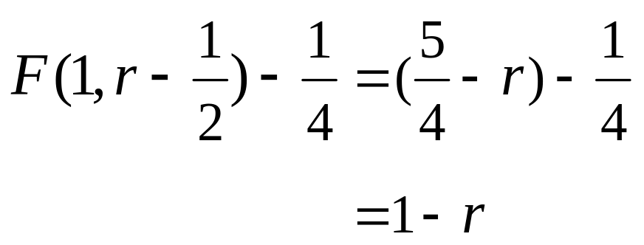
Integer Circle Algorithm
Now, the initialization is h = 1 - r
So the initial value becomes
Prepared by Narendra V G CSE MIT
Notes:
Spring 2006
CS5600

Slide 33
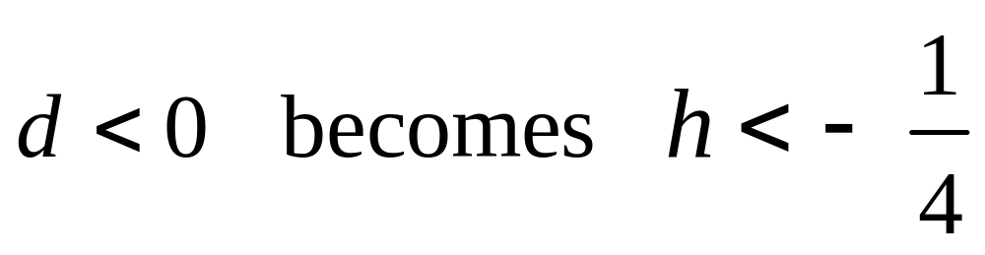
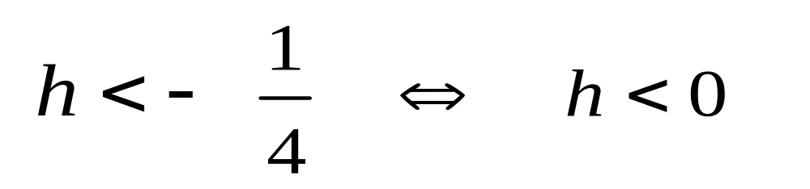
Integer Circle Algorithm
Then,
Since h an integer
Prepared by Narendra V G CSE MIT
Notes:
Spring 2006
CS5600

Slide 34
Integer Circle Algorithm
But, h begins as an integer
And, h gets incremented by integer
Hence, we have an integer circle algorithm
Note: Sufficient to test for h < 0
Prepared by Narendra V G CSE MIT
Notes:
Spring 2006
CS5600

Slide 35
Fast Circle Algorithm
void MidPointCircle(int radius )
{
x = 0;
y = radius;
d = 1- radius;
Circle_Points(x,y);
while(y>x)
{
If (d < 0) /*Select E */
d = d + 2*x + 3
else
{ /*Select SE */
d= d + 2*(x-y) + 5
y = y-1;
}
x = x+1;
Circle_Points(x,y);
}
Circle_Points(int x, int y)
{
putpixel(x,y);
putpixel(y,x);
putpixel(x,-y);
putpixel(y,-x);
putpixel(-x,-y);
putpixel(-y,-x);
putpixel(-x,y);
putpixel(-y,x);
}

Slide 36
End of Midpoint Circle
Prepared by Narendra V G CSE MIT
Notes:
Spring 2006
CS5600

